Slide 1
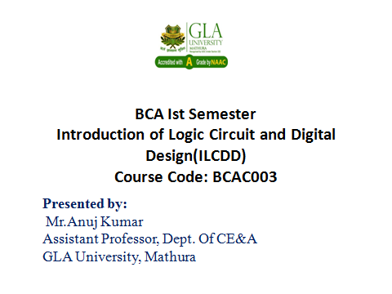

Slide 2
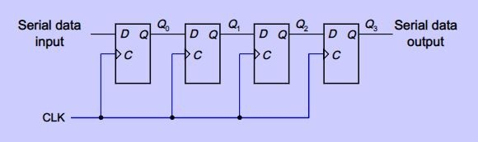
Shift Register (SISO)
A shift register “shifts” its output once every clock cycle.
It is capable of shifting its bits either to left or right
Basic shift register consists of 4 D flip flops. Output of one flip flop is connected to the intput of next D flip flop.

Slide 3
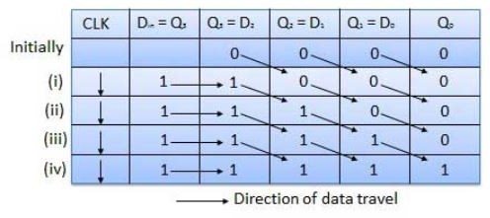
Right shift Register
Each clock pulse transfers the content of register on one bit position to right.

Slide 4
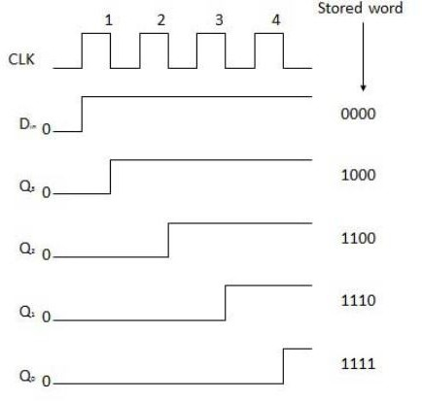

Slide 5
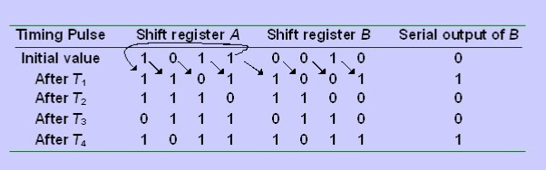
Copy data from Register A to Register B

Slide 6
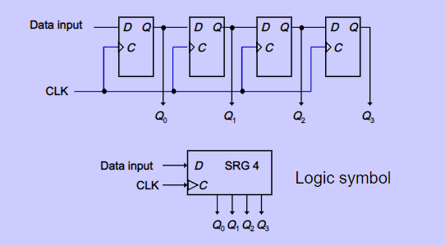
Serial In/Parallel Out

Slide 7
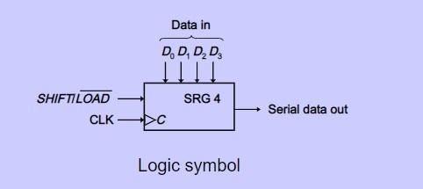
Parallel in Serial out

Slide 8
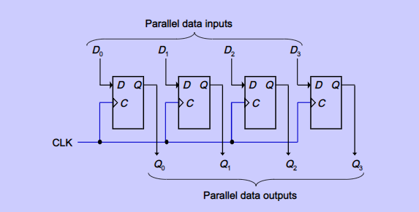
Parallel In / Parallel Out

